Slide 1

Strategic Merger Insights – LioCinema & Jotstar
Jan-Nov 2024
Prepared By: Nimmy Joy

Slide 2
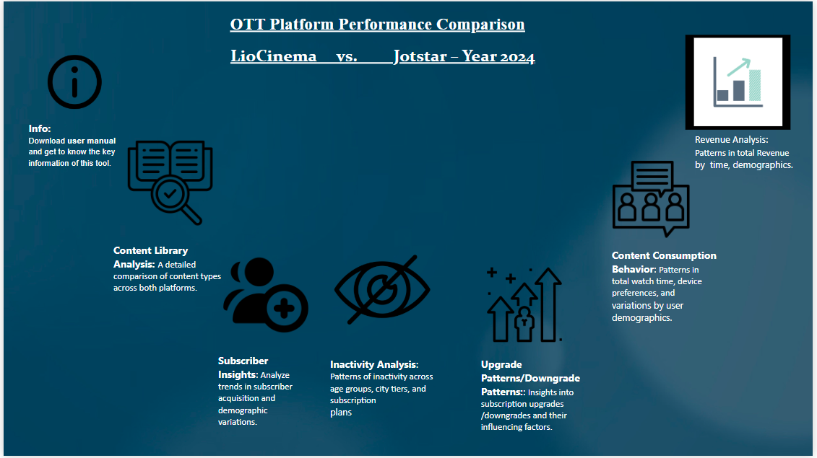

Slide 3
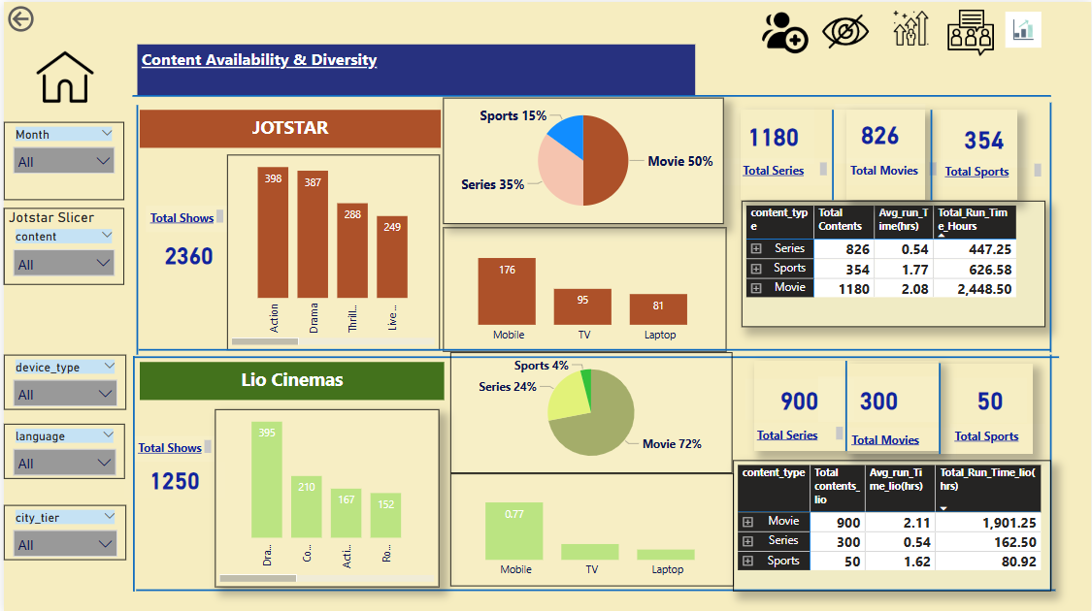

Slide 4
Insights:
Jotstar has a richer and more diverse content library, featuring more original productions.
LioCinema has a higher share of regional content, attracting a strong user base in Tier-2 and Tier-3 cities.
The most-watched genres across both platforms are drama, thriller,comedy and action.
Recommendation: Post-merger, a blended content strategy combining Jotstar’s originals and LioCinema’s regional strengths can maximize user engagement.

Slide 5
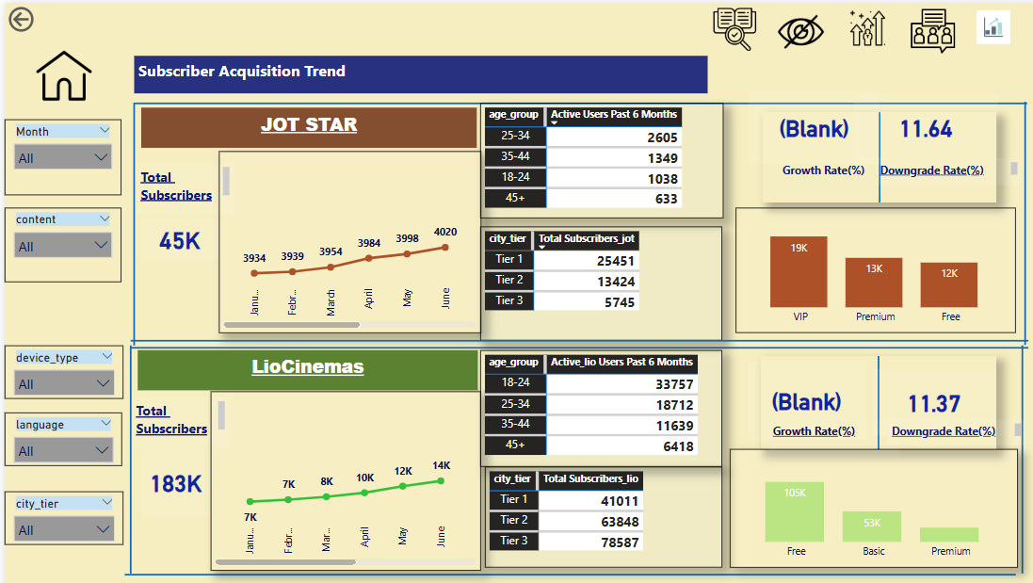

Slide 6
Insights:
LioCinema has higher subscriber numbers, but Jotstar has a stronger premium user base.
Younger audiences (18-30) prefer Jotstar, while LioCinema has a more balanced demographic spread.
Growth in subscriber acquisition for both platforms has been steady, but LioCinema’s growth is driven by bundling with telecom plans.
Recommendation:
A tiered subscription plan with exclusive content for different demographics can optimize subscriber retention and revenue.

Slide 7
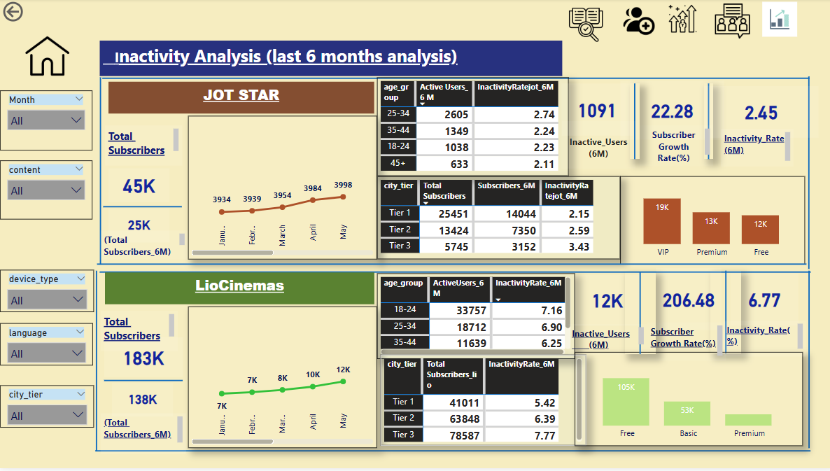

Slide 8
Insights:
Inactivity is higher among users with free or promotional subscriptions.
Users in Tier-2 and Tier-3 cities exhibit higher inactivity mab be due to inconsistent internet access.
Recommendation:
Introducing periodic engagement campaigns, personalized recommendations, and offline viewing options can reduce inactivity rates.

Slide 9
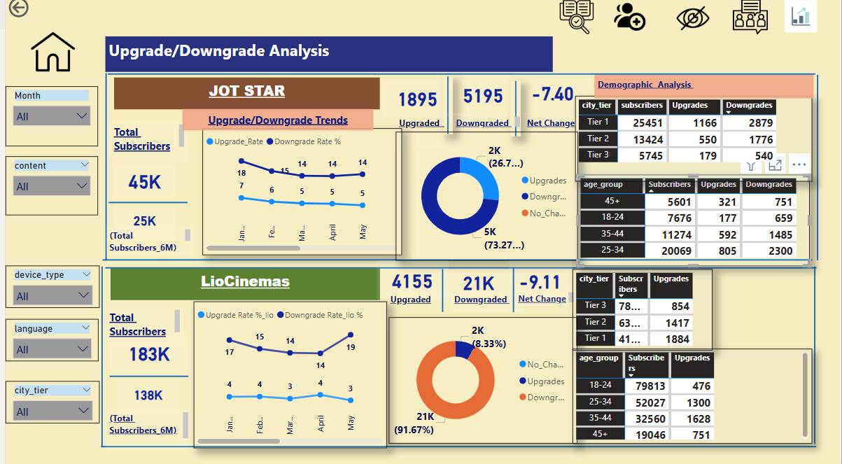

Slide 10
Insights:
Subscription upgrades are driven by exclusive content and sports events.
Downgrades are commonly linked to price sensitivity and lack of fresh content.
Users switching between platforms indicate an opportunity for bundled content packages.
Recommendation:
A loyalty program with early access to new releases and exclusive content bundles can drive upgrades and reduce downgrades.

Slide 11
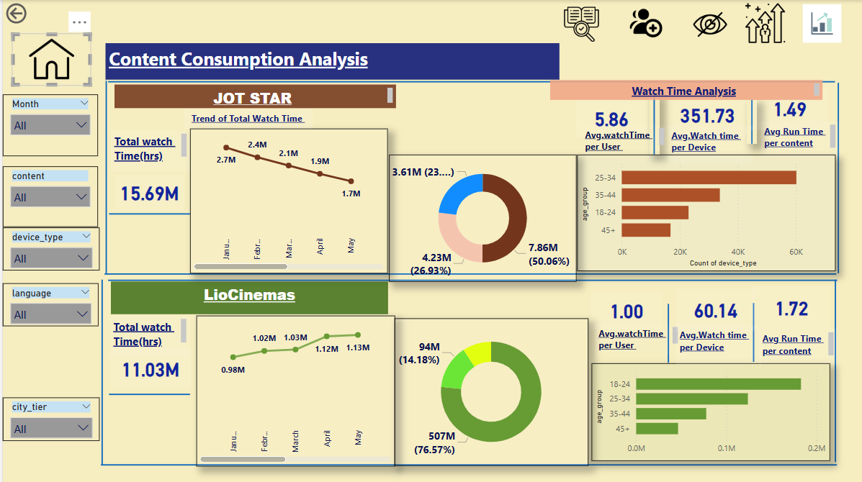
Insights:
Inactivity is higher among users with free or promotional subscriptions.
Users in Tier-2 and Tier-3 cities exhibit higher inactivity may be due to inconsistent internet access.
Recommendation:
Introducing periodic engagement campaigns, personalized recommendations, and offline viewing options can reduce inactivity rates.

Slide 12
Insights:
Mobile devices dominate content consumption, followed by smart TVs.
Short-form content is gaining popularity, especially among younger users.
Recommendation: Optimizing UI/UX for mobile users and investing in short-form and interactive content will enhance engagement.

Slide 13
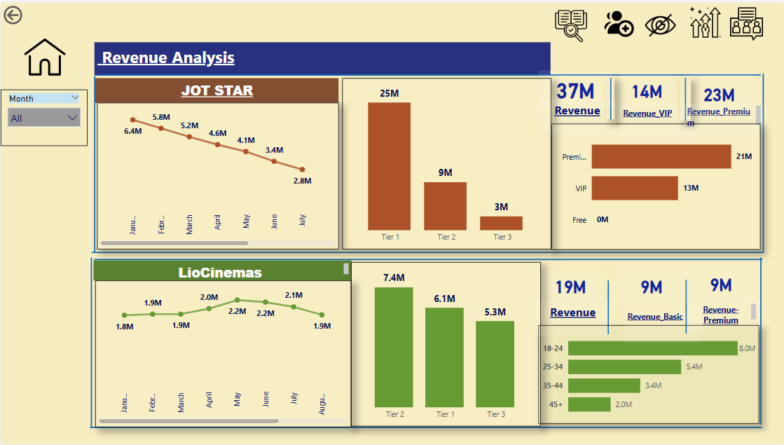

Slide 14
CONCLUSION
This merger presents an opportunity to create India’s leading OTT platform. By leveraging combined strengths—LioCinema’s user base and Jotstar’s content—we can drive growth through strategic pricing, improved user engagement, and personalized content recommendations.
Next Steps:
Implement targeted engagement strategies.
Introduce a multi-tiered subscription model.
Enhance mobile-first content experiences.

